Slide 1
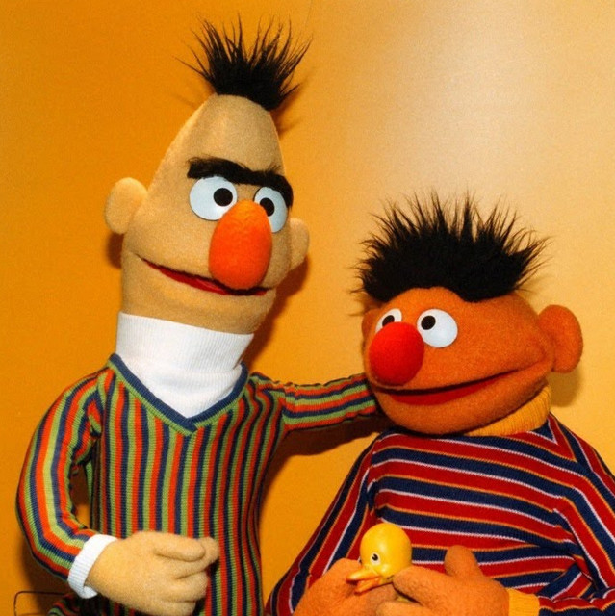
Knowledge Distillation
DistilBERT | MobileBERT | TinyBERT

Slide 2
DistilBERT
A distilled version of BERT: Smaller, faster, cheaper and lighter

Slide 3
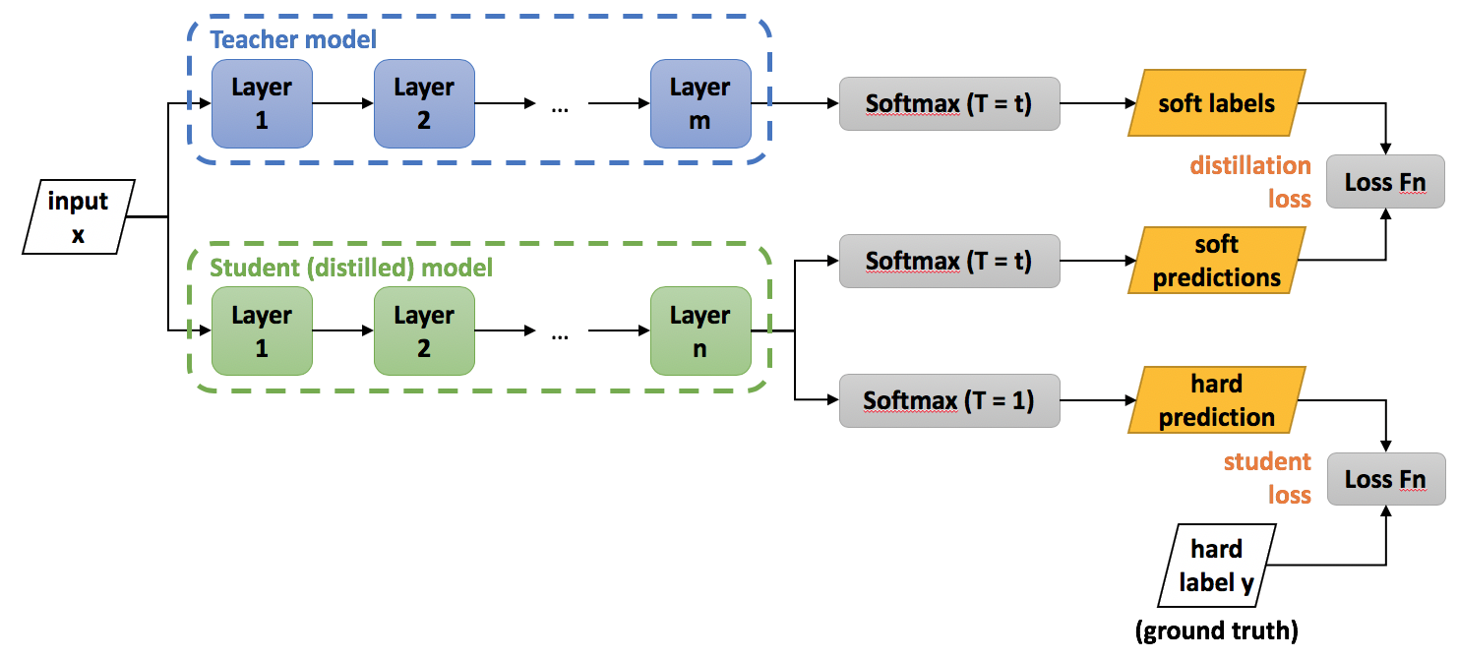
What is Knowledge Distillation?
Knowledge Distillation is a technique in machine learning where a smaller, simpler model (student) is trained to mimic the performance of a larger, more complex model (teacher).
It is done for Model compression, inference speedup and deployment efficiency

Slide 4
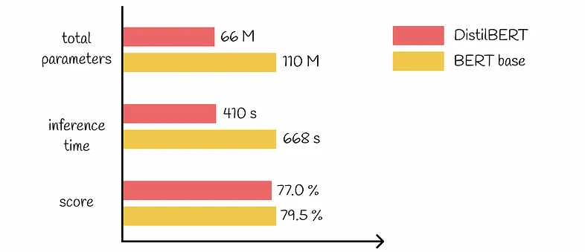
Why Distil BERT?
During inference, DistilBERT is 60% faster than BERT.
DistilBERT has 44M fewer parameters and in total is 40% smaller than BERT.
DistilBERT retains 97% of BERT performance.
BERT vs DistilBERT comparison (on GLUE dataset)

Slide 5
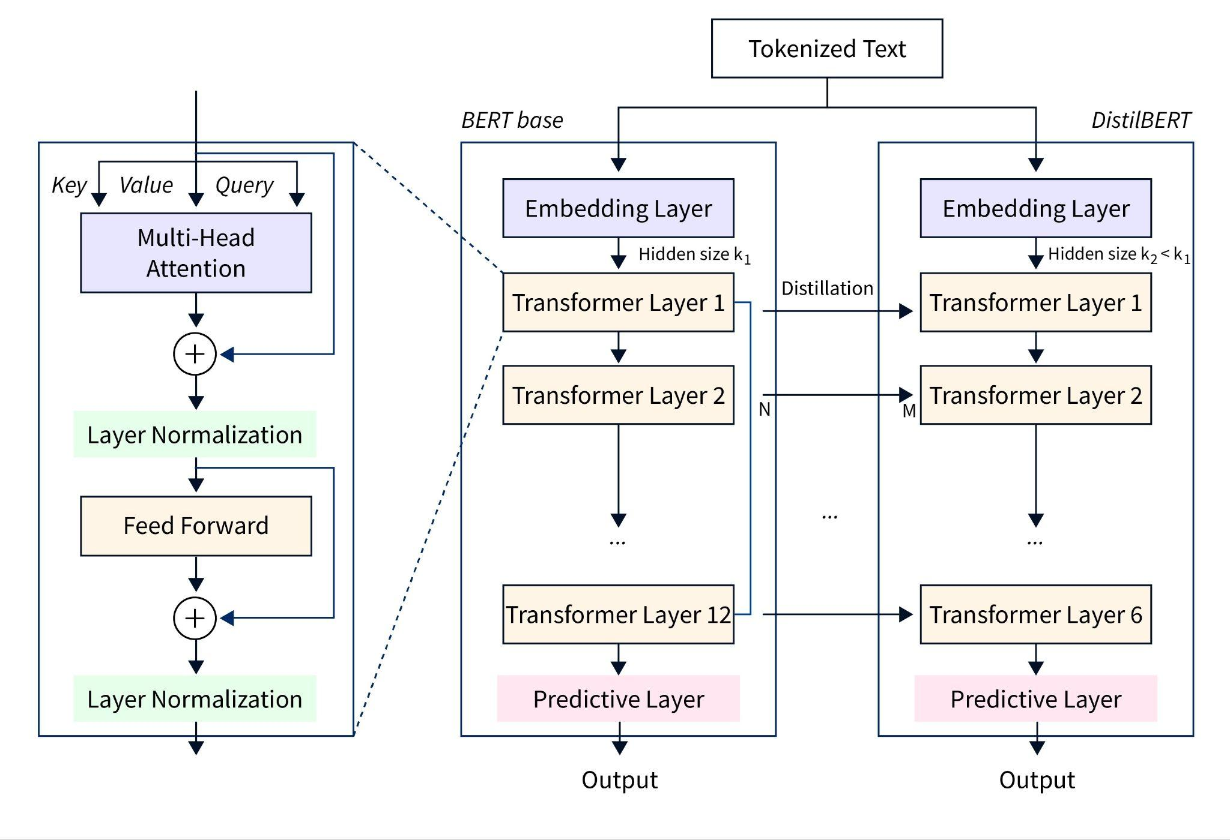
DistilBERT Architecture
DistilBERT reduces the number of layers from 12 in BERT-base to 6.
The student model (DistilBERT) is trained to predict the probability distribution over the vocabulary produced by the teacher model (BERT) using the same input text.
The student model learns to replicate the teacher’s attention patterns.
During training, optimization strategies such as temperature scaling are applied to the softmax outputs.

Slide 6
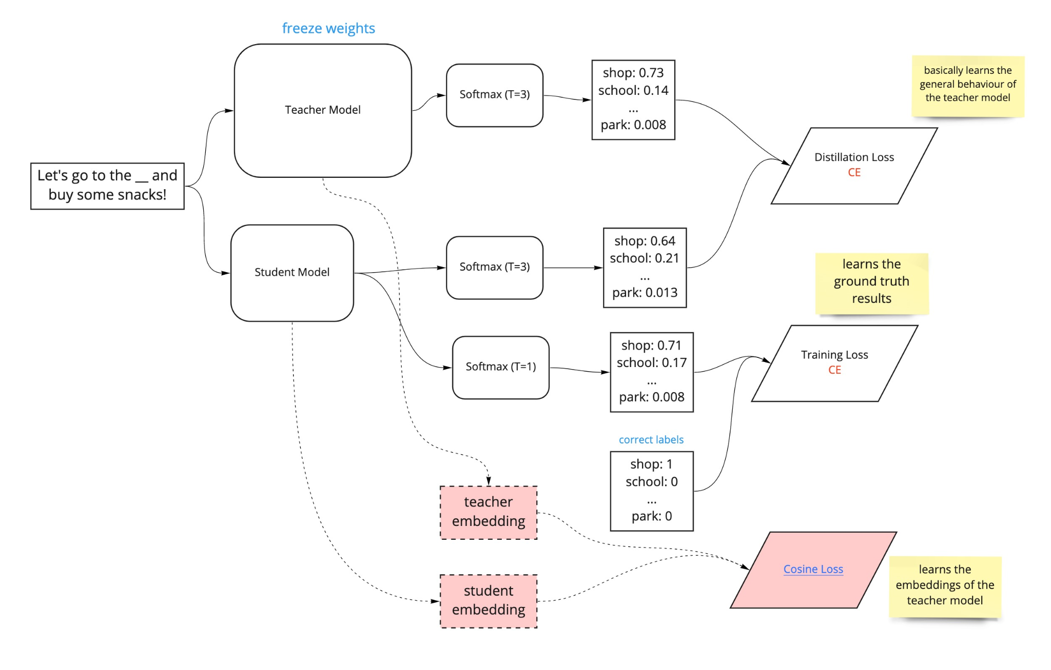
DistilBERT Loss Function
DistilBERT learns from BERT and updates its weights by using the loss function which consists of three components:
Masked language modeling (MLM) loss
Distillation loss
Similarity loss

Slide 7
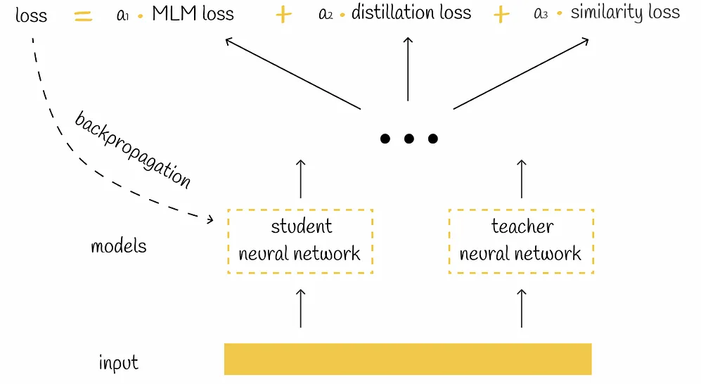
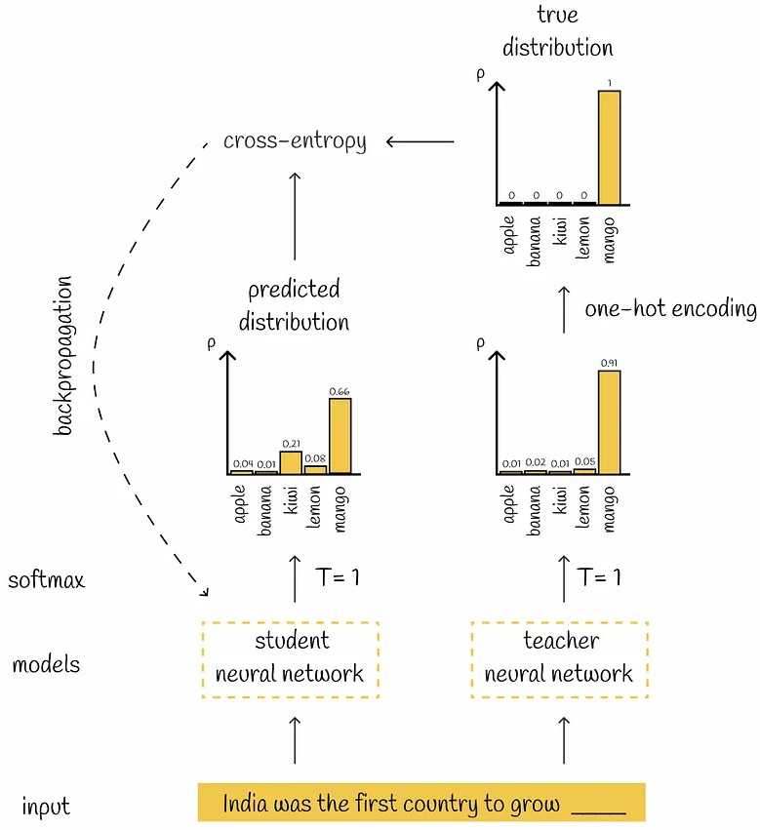
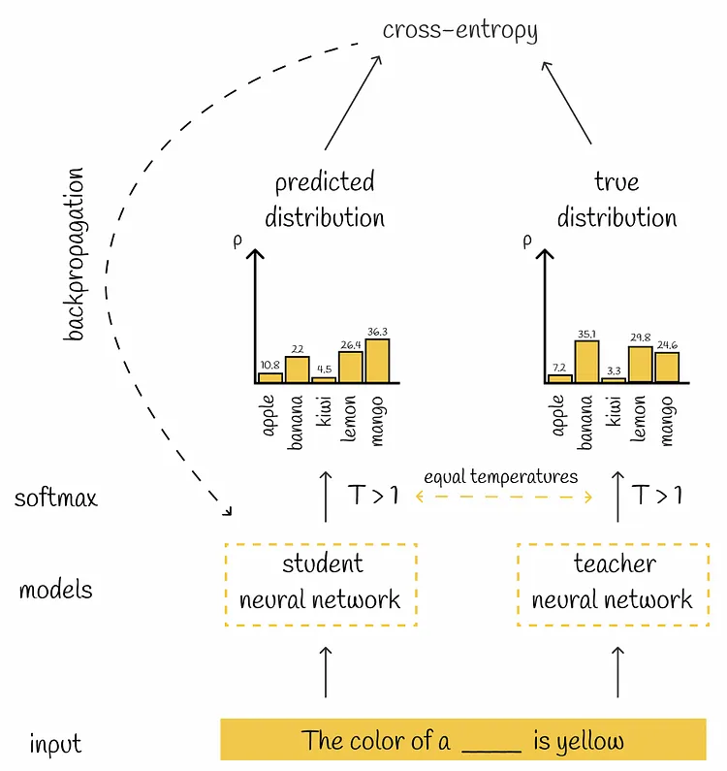
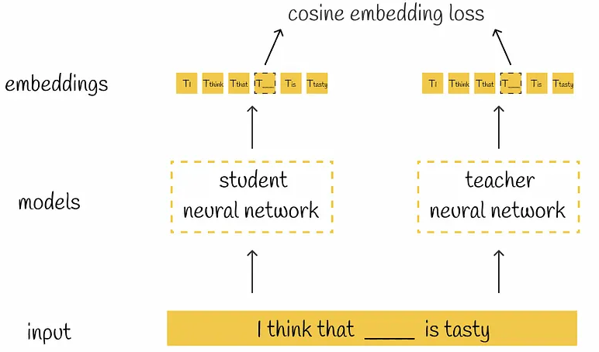
DistilBERT Loss
Triple loss
MLM loss
Similarity loss
Distillation loss

Slide 8
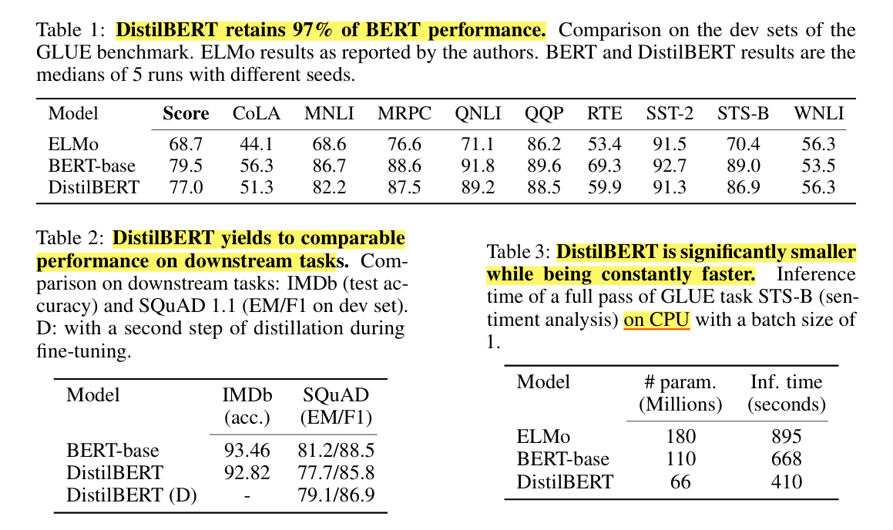
DistilBERT Performance Comparison

Slide 9
MobileBERT
a Compact Task-Agnostic BERT for Resource-Limited Devices

Slide 10
What is mobileBERT?
MobileBERT compresses and accelerates BERT to enable deployment on mobile devices with limited resources while maintaining high performance.
MobileBERT is a versatile, task-agnostic model that can be fine-tuned for various NLP tasks without task-specific modifications.
MobileBERT uses a "thin" version of BERTLARGE with bottleneck structures and balanced self-attentions and feed-forward networks to reduce computational load.
MobileBERT is trained by transferring knowledge from an inverted-bottleneck BERTLARGE (IB-BERT) model, ensuring the smaller model retains high performance.
MobileBERT is 4.3 times smaller and 5.5 times faster than BERTBASE, achieving competitive results on benchmarks like GLUE and SQuAD.

Slide 11
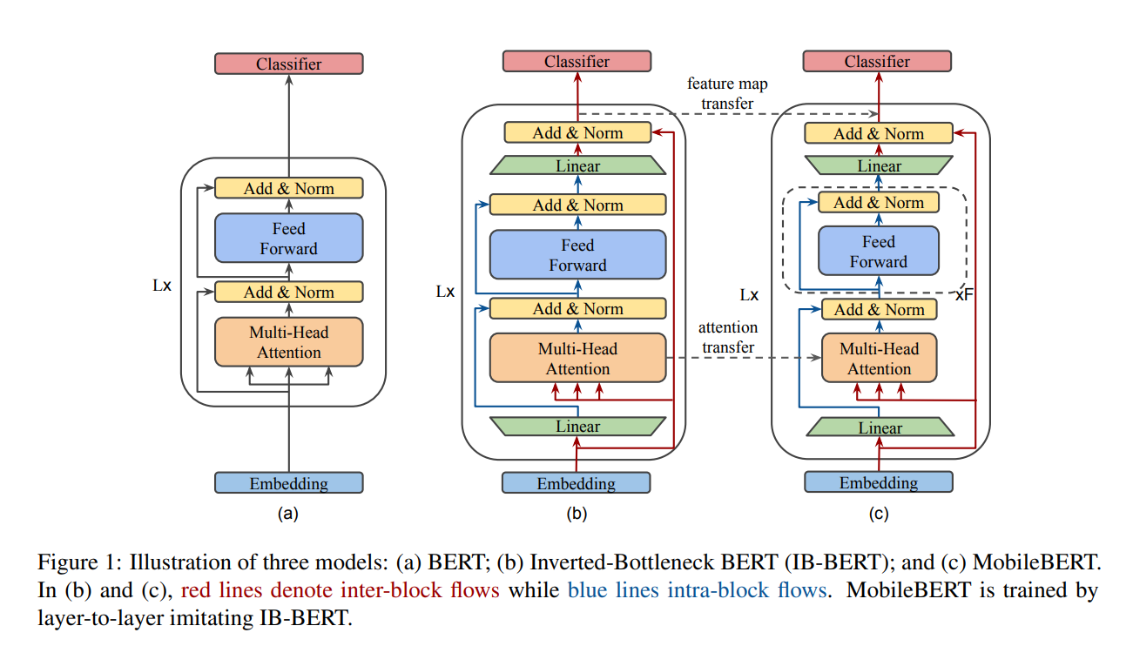
MobileBERT Architecture

Slide 12
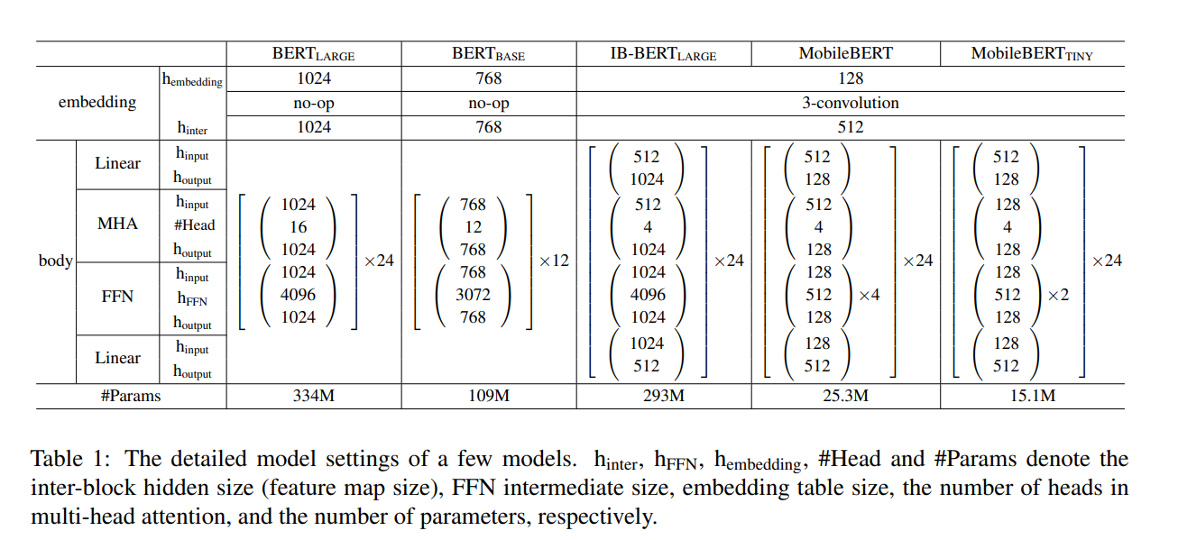
MobileBERT Model Params Settings

Slide 13
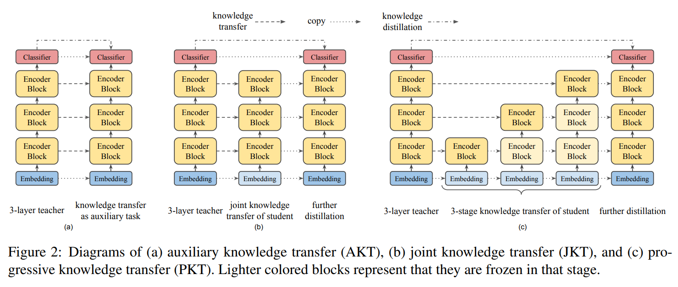
MobileBERT Knowledge Distillation

Slide 14
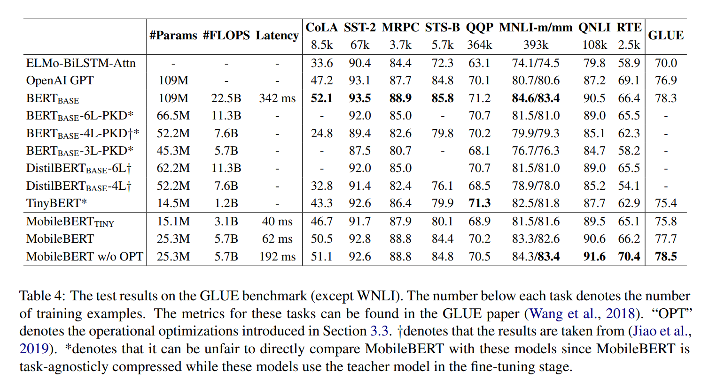
MobileBERT Benchmarking

Slide 15
TinyBERT
Distilling BERT for Natural Language Understanding

Slide 16
What is TinyBERT?
TinyBERT is created to reduce the size and improve the speed of BERT while maintaining high performance on NLP tasks.
It uses a unique Transformer distillation method to effectively transfer knowledge from a larger BERT model to a smaller TinyBERT model.
TinyBERT employs a two-stage learning process involving general distillation from a non-fine-tuned BERT and task-specific distillation from a fine-tuned BERT, enhancing both general and task-specific capabilities.
TinyBERT with 4 layers achieves over 96.8% of BERTBASE's performance on the GLUE benchmark, while being 7.5 times smaller and 9.4 times faster in inference.

Slide 17
How Similar All These Distilled Models Are?
All three models—TinyBERT, DistilBERT, and MobileBERT—aim to reduce the size of the original BERT model to make it more efficient and deployable on devices with limited computational resources.
Each model utilizes knowledge distillation techniques to transfer knowledge from a larger, more complex "teacher" model to a smaller, more efficient "student" model, preserving the teacher's capabilities while reducing computational demands.
TinyBERT, DistilBERT, and MobileBERT maintain the ability to be fine-tuned for a variety of downstream NLP tasks, making them versatile across different applications without requiring task-specific pre-training.
Despite their reduced sizes and faster inference times, all three models—TinyBERT, DistilBERT, and MobileBERT—achieve performance that is competitive with or close to the original BERT model on various NLP benchmarks.

Slide 18
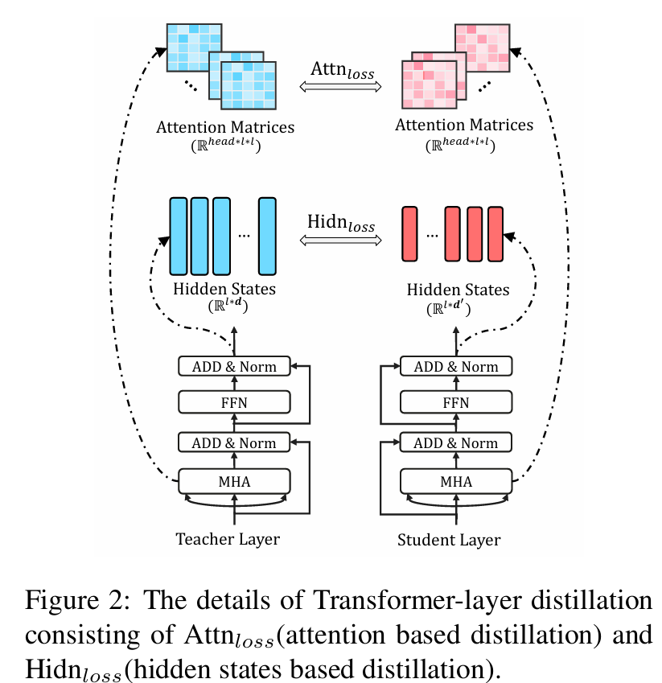
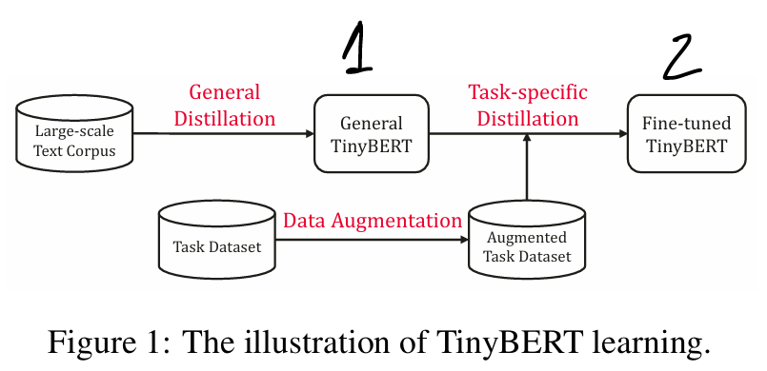
TinyBERT Distillation
It propose a novel two-stage learning framework including the general distillation and the task-specific distillation,
It has three types of loss functions to fit different representations from BERT layers:
the output of the embedding layer;
the hidden states and attention matrices derived from the Transformer layer;
the logits output by the prediction layer.

Slide 19
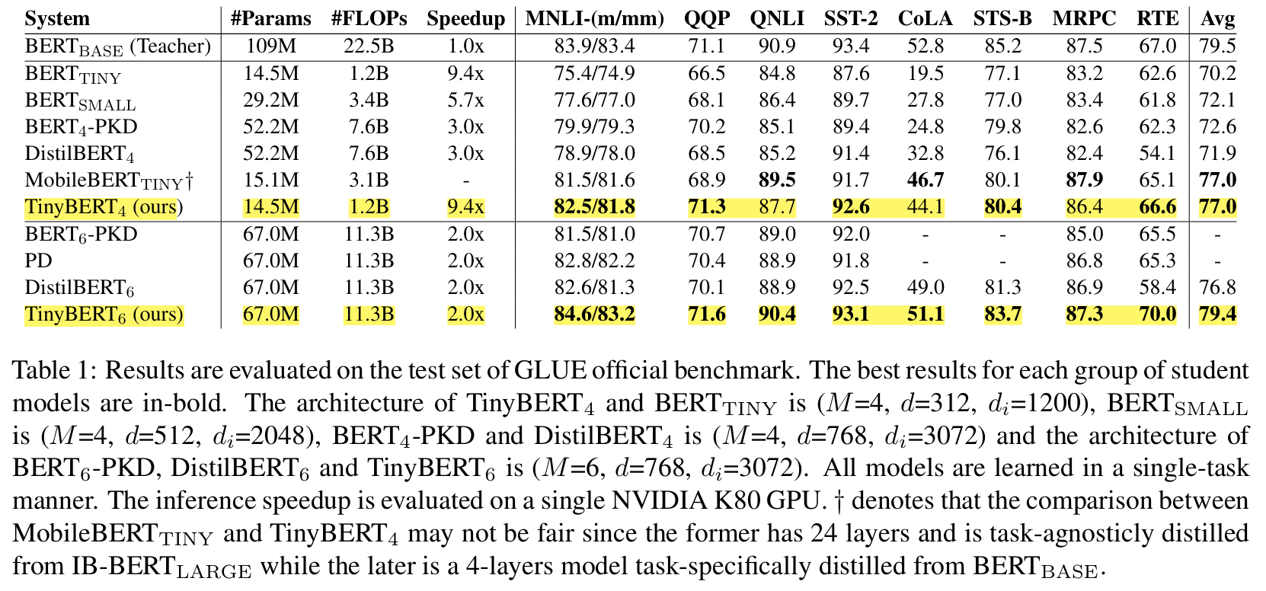
TinyBERT Model Performance

Slide 20
Thanks

